Slide 1
Why formula 1 is boring
Use the Machine Learning Workflow to process and transform Formula 1 data to create a prediction model. This model must predict Which drivers are likely to finish on the podium with 85% or greater accuracy.”

Slide 2
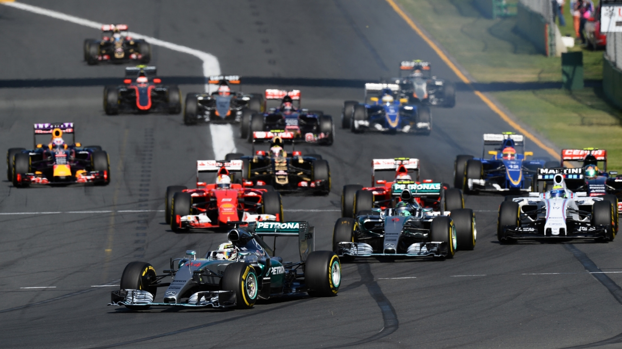
Data Collection
Main features:
Team, Investment, Driver, Previous Team History, Previous Driver History.
Sub features:
Practice Results, Qualifying Results (Boring)
Approaches:
Binary Classification (podium, points)
Regression (finishing position)

Slide 3
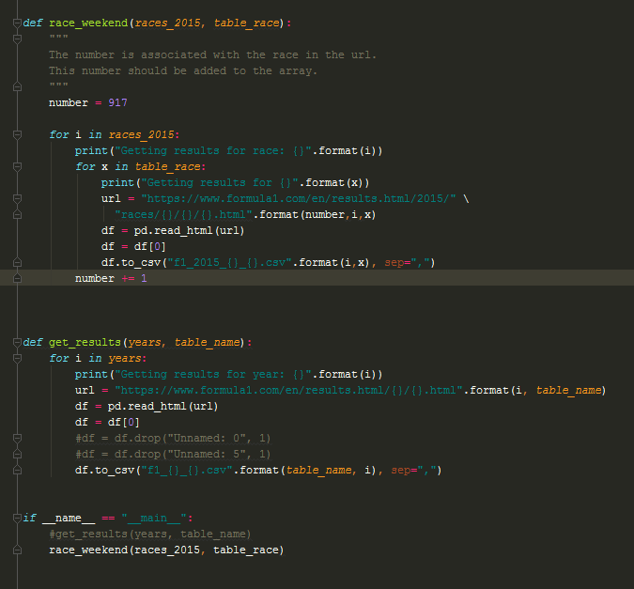
Gathering the data w/
Web Scraping!

Slide 4
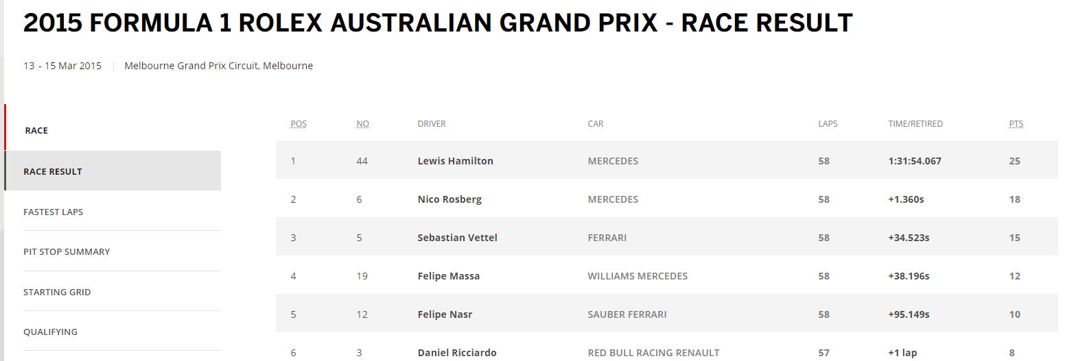
Formatting
Data from the tables provided give little useful information.

Slide 5
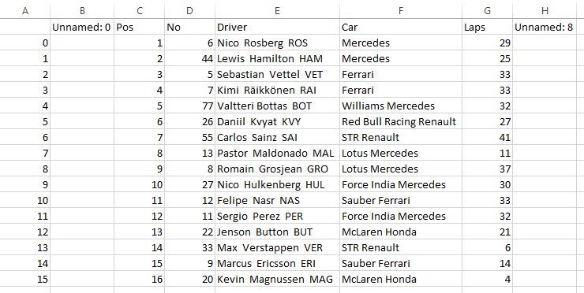

Slide 6
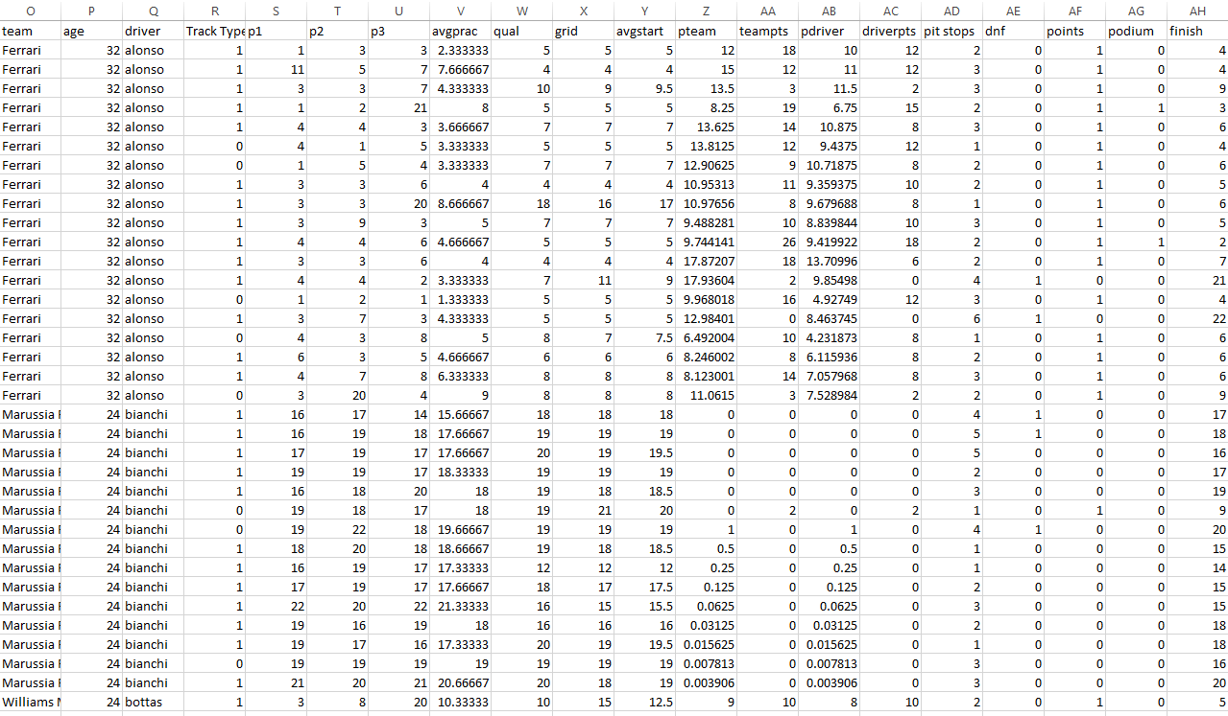

Slide 7

To the code batman!

Slide 8
Summary
Evaluated Naïve Bayes model
Predict()
confusionMatrix()
Tried using Random Forest algorithm
Overfit
Improved performance with Logistic Regression and CV

